Slide 1
16-bit MS-DOS and BIOS Programming
Department of Computer Science
National Tsing Hua University

Slide 2
Overview
Chapter 13: 16-bit MS-DOS Programming
MS-DOS and the IBM-PC
MS-DOS Function Calls (INT 21h)
Standard MS-DOS File I/O Services
Chapter 15: BIOS-Level Programming
Keyboard Input with INT 16h
VIDEO and Graphics
Mouse Programming
How Does a PC Boot?
  http://www.pcguide.com/ref/mbsys/bios/boot.htm

Slide 3
Assembly Language for Intel-Based Computers, 5th Edition
Kip Irvine
Chapter 13: 16-Bit MS-DOS Programming
Slides prepared by the author
Revision date: June 4, 2006
(c) Pearson Education, 2006-2007. All rights reserved. You may modify and copy this slide show for your personal use, or for use in the classroom, as long as this copyright statement, the author's name, and the title are not changed.

Slide 4
Real-Address Mode
Real-address mode (16-bit mode) programs have the following characteristics:
  Max 1 megabyte addressable RAM
  Single tasking
  No memory boundary protection
  Offsets are 16 bits
IBM PC-DOS: first real-address OS for IBM-PC
  Has roots in Gary Kildall's highly successful Digital Research CP/M
  Later renamed to MS-DOS, owned by Microsoft

Slide 5
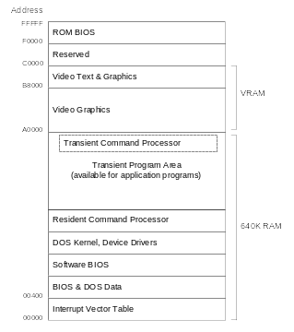
MS-DOS Memory Map

Slide 6
MS-DOS Memory Organization
Lowest 640K bytes: used by OS and applications
  Interrupt Vector Table (1K bytes, 00000 – 003FF)
  BIOS and DOS data
  Software BIOS
  MS-DOS kernel
  Resident command processor (命令提示字元)
  Transient programs
Video graphics and text
Reserved (device controllers)
ROM BIOS (F0000 to FFFFF)

Slide 7
Interrupt
If you call your friend and his/her mom says he/she is not home, what do you do?
Do something else, and get interrupted when he/she is back and returns your call.
When you are interrupted by a phone ring, you must somehow know who is interrupting you and what he/she wants.
Based on the type of interrupts, you then do the required operations.
After serving the interrupt, you return to the operations before interrupt.

Slide 8
Interrupt
You may be interrupted by external events, e.g. phone ring, or internal events, e.g. fetch a soda while studying.
Analog in processor:
  Interrupts may be triggered by hardware, e.g. I/O devices, which is outside of your program.
  Interrupts may also be trigger by software, e.g. program faults or system service calls, which is generated by your program itself.
Software interrupt:
  A call to an OS procedure (interrupt handler), mainly for I/O

Slide 9
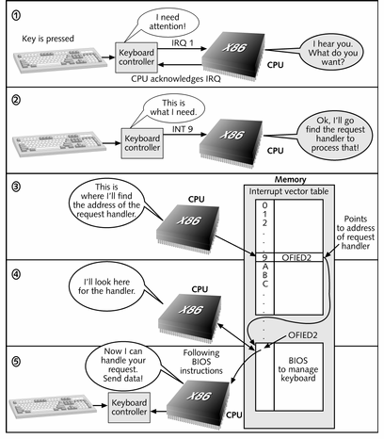
Hardware Interrupts

Slide 10
Hardware Device Initialization
At startup, a hardware device is assigned:
  An IRQ by which it can signal the CPU that it needs attention
  Some I/O addresses by which the CPU and the device can communicate
  Some memory addresses that indicate where the program to manage the device can be stored
  Perhaps a DMA channel to speed up sending its data to memory

Slide 11
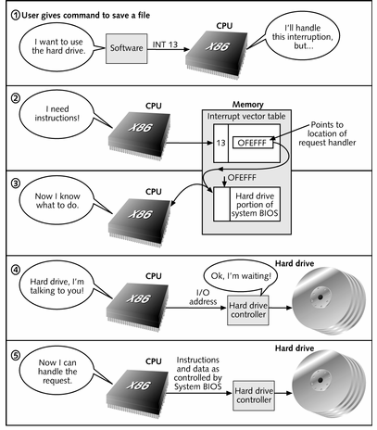
Software Interrupts

Slide 12
INT Instruction
Executes a software interrupt to request MS-DOS services
  The code that handles the interrupt is called an interrupt handler (or interrupt service routine (ISR))
Syntax:
The Interrupt Vector Table (IVT) maps an interrupt number to a 32-bit segment-offset address for each interrupt handler.
INT number (number = 0..FFh)

Slide 13
INT Vectors
In Interrupt Vector Table in 00000h-003FFh (1KB)
For the execution of INT 00-FF
Each INT uses a 4-byte vector (CS:IP):
  2 bytes for IP
  2 bytes for CS
Actual code (Service Routine) is in CS:IP
IRET at the end of INT Service Routine

Slide 14
Interrupt Vectoring Process

Slide 15
Interrupt Vectoring Process
Step 1:
  The operand of INT is multiplied by 4 to locate the matching interrupt vector table entry
Step 2:
  CPU pushes flags and a 32-bit return address on stack, disables hardware interrupts, and calls using the address stored at location (10h * 4) in the interrupt vector table (F000:F065)
Step 3:
  Interrupt handler executes until IRET is reached
Step 4:
  Pop the stack and return to application program

Slide 16
INT Vectors: Example
Main proc
MOV AX,@data
MOV DS, AX
…
…
INT 21h
Main endp
PUSH DX
PUSH CX
…
…
IP
CS
0h
4h
×4
…
…
84h
…
…
3FFh

Slide 17
Common Interrupts
Software interrupts will call interrupt service routines (ISRs) either in BIOS or DOS
INT 10h Video Services
INT 16h Keyboard Services
INT 17h Printer Services
INT 1Ah Time of Day
INT 1Ch User Timer Interrupt
INT 21h MS-DOS Services
Note that we will use the 16-bit mode in the following slides

Slide 18
What's Next
MS-DOS and the IBM-PC
MS-DOS Function Calls (INT 21h)
Standard MS-DOS File I/O Services

Slide 19
Function 4Ch of INT 21h
Terminate process:
  Ends the current process (program), returns an optional 8-bit return code to the calling process.
  A return code of 0 usually indicates successful completion.
mov ah,4Ch ; terminate process
mov al,0 ; return code
int 21h
; Same as:
.EXIT 0

Slide 20
Example of INT for I/O
INT 21h: invoke MS-DOS services
  Function code in AH, e.g. 09H = write string
  The string must be terminated by a '$' character.
  DS must point to the string's segment, and DX must contain the string's offset.
.data
string BYTE “Hello, World!$"
.code
mov ah,9
mov dx,OFFSET string
int 21h

Slide 21
Selected I/O Functions
Output functions:
  02h, 06h - Write character to standard output
  05h - Write character to default printer
  09h - Write string to standard output
  40h - Write string to file or device
Input functions:
  01h, 06h - Read character from standard input
  0Ah - Read array of buffered characters from standard input
  0Bh - Get status of the standard input buffer
  3Fh - Read from file or device

Slide 22
INT 21h Function 05h
Write character to default printer
  Write the letter 'A':
  Write a horizontal tab:
mov ah,05h
mov dl,65
int 21h
mov ah,05h
mov dl,09h
int 21h

Slide 23
INT 21h Function 40h
Write string to file or device
  BX = file or device handle (console = 1), CX = # bytes to write, DS:DX = address of array
.data
message "Writing a string to the console"
bytesWritten WORD ?
.code
  mov ah,40h
  mov bx,1
  mov cx,LENGTHOF message
  mov dx,OFFSET message
  int 21h
  mov bytesWritten,ax

Slide 24
INT 21h Function 01h
Read single character from standard input
  Echoes the input character
  Waits for input if the buffer is empty
  Checks for Ctrl-Break (^C)
  Acts on control codes such as horizontal Tab
.data
char BYTE ?
.code
mov ah,01h
int 21h
mov char,al

Slide 25
Example: Hello World!
.model small
.stack 100h
.386
.data
message BYTE "Hello, world!",0dh,0ah
.code
main PROC
mov ax,@data ; initialize DS
mov ds,ax
mov ah,40h ; write to file/device
mov bx,1 ; output handle
mov cx,SIZEOF message ; number of bytes
mov dx,OFFSET message ; addr of buffer
int 21h
.exit
main ENDP
END main

Slide 26
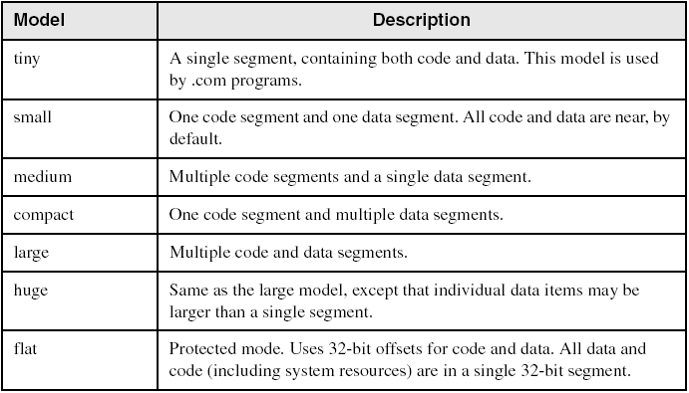
Memory Models
(Table 8-2, page 247)

Slide 27
.MODEL Directive
The .MODEL directive determines the names and grouping of segments
  .MODEL memory_model, language, stackdistance
Language can be:
  C, BASIC, FORTRAN, PASCAL, SYSCALL, or STDCALL (details in Chapters 8 and 12)
  Determine calling and naming convention for procedures ad public symbols
Stackdistance can be:
  NEARSTACK: (default) places the stack segment along with the data segment
  FARSTACK: stack and data not grouped together

Slide 28
.STACK Directive
Syntax:
  .STACK [stacksize]
Stacksize specifies size of stack, in bytes
  default is 1024
Example: set to 2048 bytes:
  .stack 2048

Slide 29
Assembly Language for Intel-Based Computers, 5th Edition
Kip R. Irvine
Chapter 15: BIOS-Level Programming
Slide show prepared by the author
Revision date: June 4, 2006
(c) Pearson Education, 2006-2007. All rights reserved. You may modify and copy this slide show for your personal use, or for use in the classroom, as long as this copyright statement, the author's name, and the title are not changed.

Slide 30
Chapter Overview
Introduction
Keyboard Input with INT 16h
VIDEO Programming with INT 10h
Drawing Graphics Using INT 10h
Memory-Mapped Graphics
Mouse Programming

Slide 31
PC-BIOS
BIOS (Basic Input-Output System) provides low-level hardware drivers for the operating system
  Accessible to 16-bit applications
  Written in assembly language
  Source code published by IBM in early 1980's
Advantages over MS-DOS:
  Permits graphics and color programming
  Faster I/O speeds
  Read mouse, serial port, parallel port
  Low-level disk access

Slide 32
BIOS Data Area
Fixed-location data area at address 00400h
  This area is also used by MS-DOS
  Also accessible under Windows 98 & Windows Me, but not under Windows NT, 2000, or XP.
Contents: (Table 15-1, page 491)
  Serial and parallel port addresses
  Hardware list, memory size
  Keyboard status flags, keyboard buffer pointers, keyboard buffer data
  Video hardware configuration
  Timer data

Slide 33
BIOS Data Area at 0x0040:0x0000
Offset | Size (bytes) | Description
0000 ~ 0007 | 8 | Base I/O address of serial port 1 ~ 4
0008 ~ 000F | 8 | Base I/O address of parallel port 1 ~ 4
0x10 | 2 | Equipment word
0x12 | 1 | Manufacturing test data
0x13 | 2 | Memory size in Kb
0x15 | 2 | Manufacturing test data
0x17 | 2 | Keyboard status flag
0x19 | 1 | Alt + Numpad data
0x1A | 2 | Keyboard buffer head
0x1C | 2 | Keyboard buffer tail
0x1E | 32 | Keyboard buffer
(more entries)

Slide 34
How the Keyboard Works
Keyboard controller chip sends an 8-bit scan code to the keyboard serial input port
Interrupt triggered, INT 9h routine executes
Scan code and ASCII code inserted into keyboard typeahead buffer

Slide 35
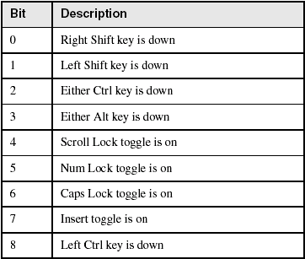
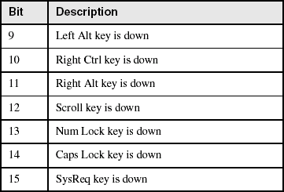
Keyboard Flags
16-bits, located at 0040:0017h – 0018h

Slide 36
INT 16h Functions
Provide low-level access to the keyboard, more so than MS-DOS.
Input-output cannot be redirected at the command prompt.
Function number is always in the AH register
Important functions:
  set typematic rate
  push key into buffer
  wait for key
  check keyboard buffer
  get keyboard flags

Slide 37
Function 10h: Wait for Key
If a key is waiting in the buffer, the function returns it immediately. If no key is waiting, the program pauses (blocks), waiting for user input.
.data
scanCode BYTE ?
ASCIICode BYTE ?
.code
mov ah,10h
int 16h
mov scanCode,ah
mov ASCIICode,al

Slide 38
Example: Display Keystrokes
Include Irvine16.inc
.code
main PROC
mov ax,@data
mov ds,ax
call ClrScr ; clear screen
L1: mov ah,10h ; keyboard input
int 16h ; using BIOS
call DumpRegs ; AH=scan, AL=ASCII
cmp al,1Bh ; ESC key pressed?
jne L1 ; no: repeat the loop
call ClrScr ; clear screen
exit
main ENDP
END main

Slide 39
Function 12h: Get Keyboard Flags
Retrieves a copy of the keyboard status flags from the BIOS data area
.data
keyFlags WORD ?
.code
mov ah,12h
int 16h
mov keyFlags,ax

Slide 40
Overview
How Does a PC Boot?
  http://www.pcguide.com/ref/mbsys/bios/boot.htm

Slide 41
Boot Process
Step 0: CPU Reset
  Blank memory, except ROM
  Start running from address FFFF0 (only 16 bytes left!)
Step 1: Power-on self test (POST)
Step 2: ROM BIOS startup program searches for and loads an OS
Step 3: OS configures the system and completes its own loading
Step 4: User executes applications software

Slide 42
Step 1: POST & BIOS Boot
A built-in diagnostic program that checks the hardware to ensure that everything is present and functioning properly, before the BIOS begins the actual boot.
It then continues with additional tests, e.g., memory test, as boot process is proceeding.
The ROM BIOS startup program surveys hardware resources and needs, and assigns system resources to meet those needs

Slide 43
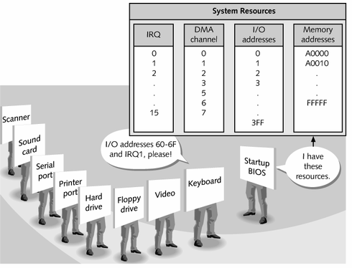
POST

Slide 44
Step 2: BIOS Finds & Loads OS
Most often the OS is loaded from logical drive C on the hard drive
Configuration information on CMOS chip tells startup BIOS where to look for the OS
BIOS turns to that device, reads the beginning files of the OS, copies them into memory, then turns control over to the OS
  Master Boot Record (MBR) loaded.

Slide 45
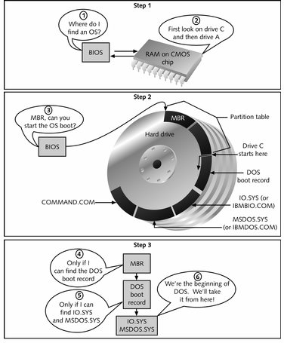
BIOS Finds & Loads OS

Slide 46
Step 3: OS Completes Boot
The OS checks some of the same things that startup BIOS checked (e.g., available memory and whether memory is reliable)
The OS loads software to control the mouse, a CD-ROM, a scanner, and other peripheral devices (generally have device drivers)

Slide 47
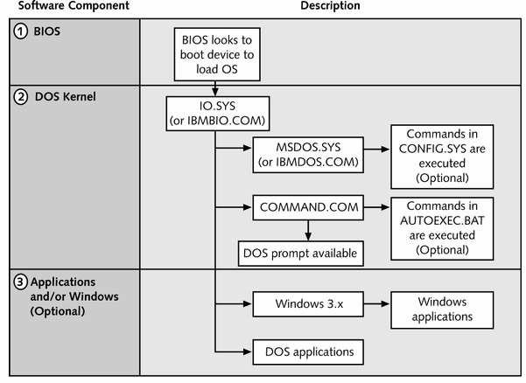
Boot Process

Slide 48
Step 4: User Executes Applications Software
The OS finds the applications software (on a secondary storage device), copies software into memory, and turns control over to it
User commands the applications software, which makes requests to the OS, which uses the system resources, system BIOS, and device drivers to interface with and control the hardware

Slide 49
Summary
MS-DOS applications
  16-bit segments, segmented addressing, running in real-address mode
Software interrupts
  processed by interrupt handlers
INT (call to interrupt procedure) instruction
  pushes flags & return address on the stack
  uses interrupt vector table to find handler
BIOS Services (INT 10h, INT 16h, INT 17h, ...)
MS-DOS Services (INT 21h)
PC Guide – BIOS System Boot http://www.pcguide.com/ref/mbsys/bios/boot.htm

